Slide 1
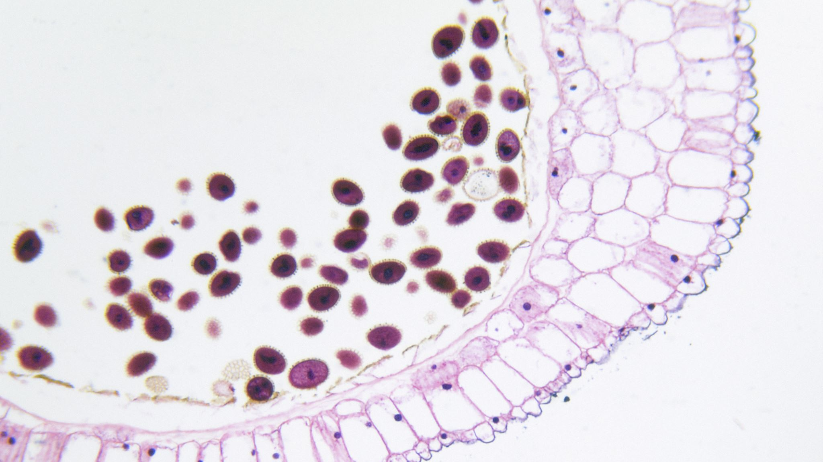

Invasive Ductal Carcinoma Detection
Barbara Payne

Slide 2
Invasive Ductal Carcinoma
Most common type of breast cancer
2/3 women aged 55+
Symptoms
Detection

Slide 3
Convolutional Neural Networks
Used for image classification and recognition
Two components
Works in one dimensional data
Four important hyperparameters

Slide 4
Dataset
https://www.kaggle.com/paultimothymooney/breast-histopathology-images
All images
198,738 negative
78,786 positive

Slide 5
Methods
Exploratory Data Analysis
Training dataset
Testing dataset

Slide 6
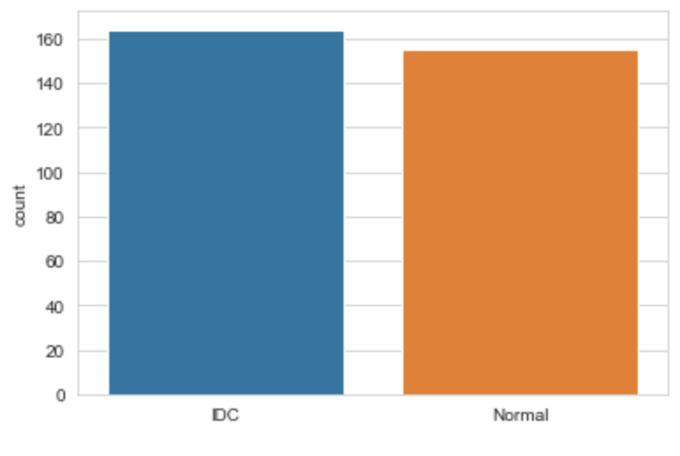
Results - EDA

Slide 7
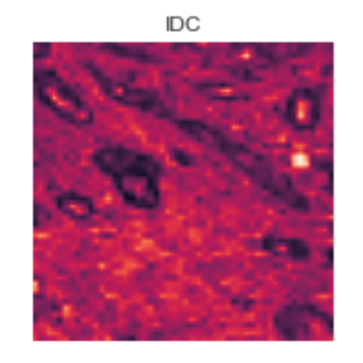
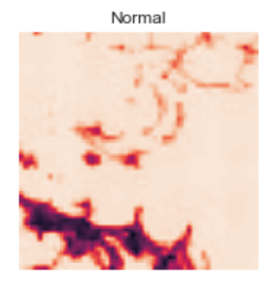
Results

Slide 8
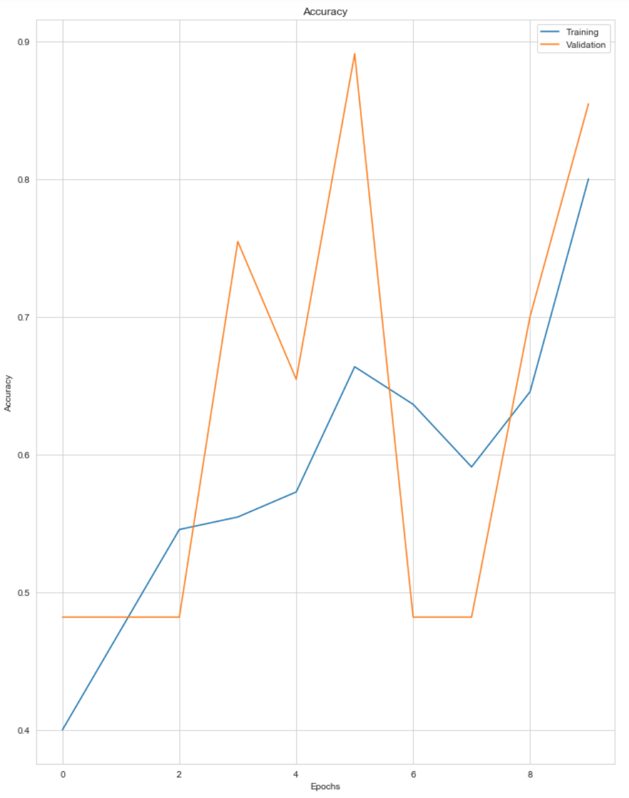
Results - Accuracy

Slide 9
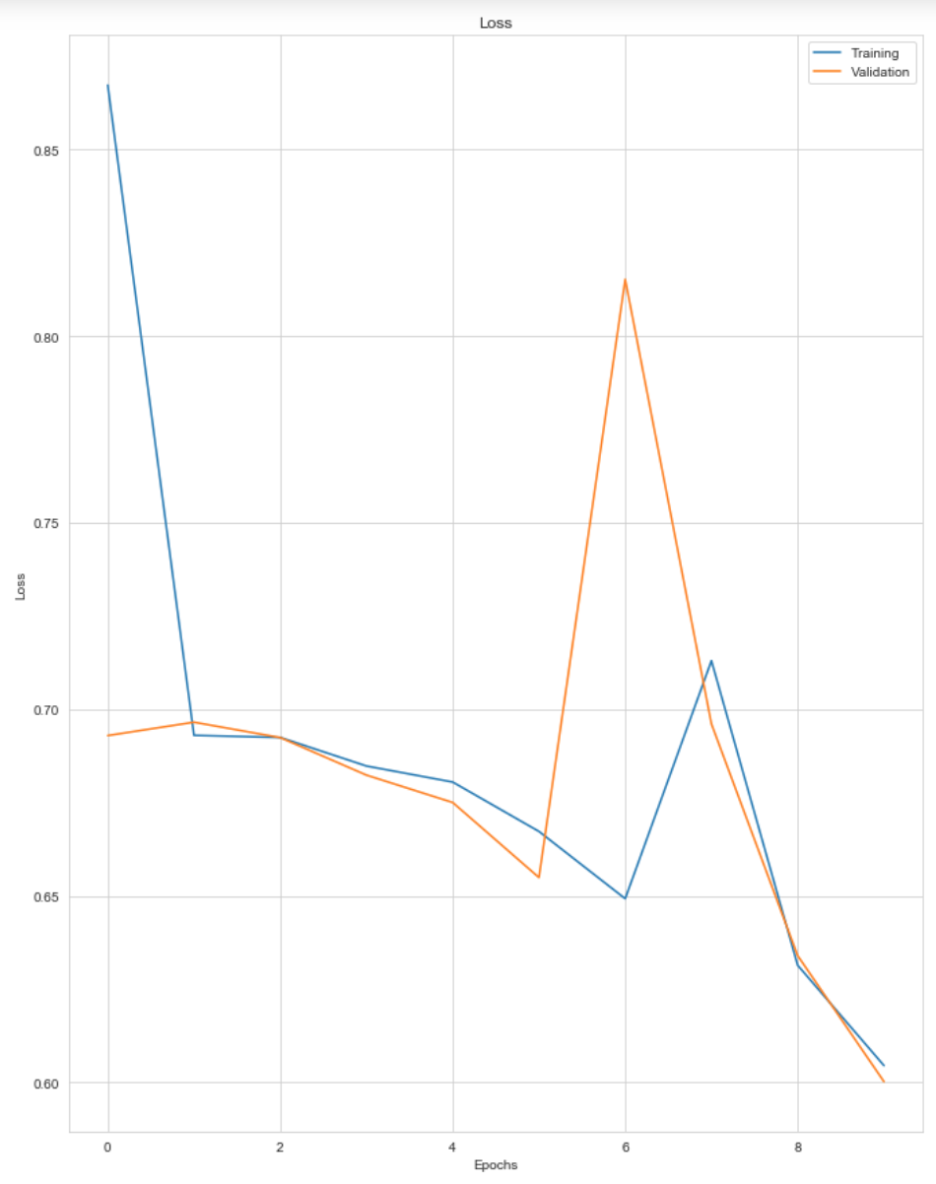
Results - Loss

Slide 10
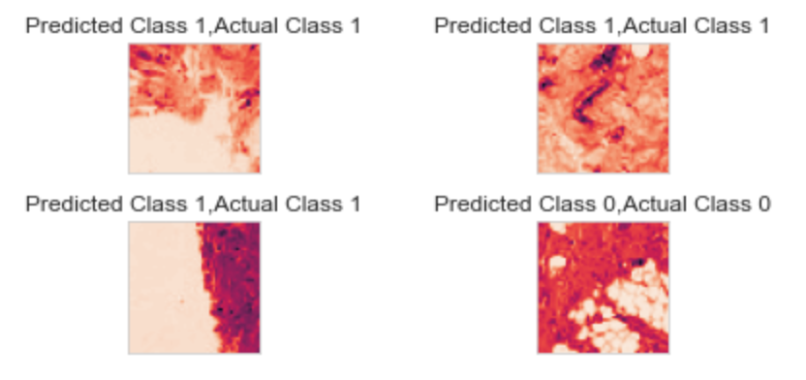
Results – Correct Predictions

Slide 11
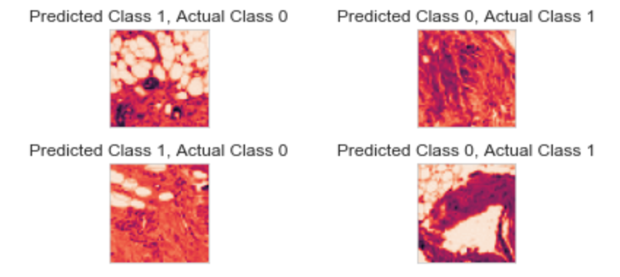
Results – Incorrect Predictions

Slide 12
Conclusion
More improvements to be made
High accuracy
High loss
Importance of machine learning

Slide 13

Thank you

